Slide 1
Access 2016 Module 2
Building and Using Queries

Slide 2
Module Objectives
Use the Query Wizard
Work with data in a query
Use Query Design View
Sort and find data
Filter data
Apply AND criteria
Apply OR criteria
Format a datasheet

Slide 3
Use the Query Wizard (Slide 1 of 2)
A query allows you to select a subset of fields and records from one or more tables and then present the selected data as a single datasheet
Because a query doesn’t physically store the data, a query datasheet is sometimes called a logical view of the data
A query stores a set of SQL (Structured Query Language) commands
Query Design View is an Access tool for writing queries without using SQL

Slide 4
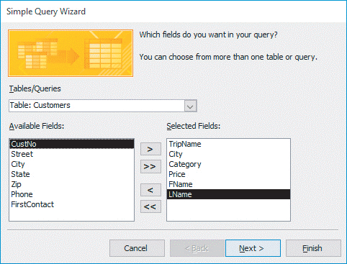
Use the Query Wizard (Slide 2 of 2)
Simple Query Wizard

Slide 5
Work with Data in a Query (Slide 1 of 2)
You enter and edit data in a query datasheet the same way you do in a table datasheet
Any edits you make in a query datasheet are permanently stored in the underlying tables, and are automatically updated in all views of the data in other queries, forms, and reports

Slide 6
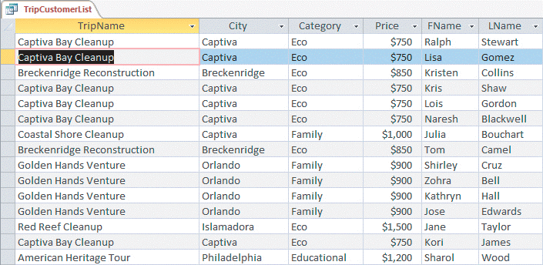
Work with Data in a Query (Slide 2 of 2)
Working with data in a query datasheet
Updating Stanley to Captiva in one record updates all records

Slide 7
Use Query Design View (Slide 1 of 2)
Use Query Design View to:
Add, delete, or move the fields in an existing query, to specify sort orders, or to add criteria to limit the number of records shown in the resulting datasheet
Create a new query from scratch
Query Design View presents the fields you can use for that query in small windows called field lists
If you use the fields of two or more related tables in the query, the relationship between two tables is displayed with a join or link line identifying which fields are used to establish the relationship

Slide 8
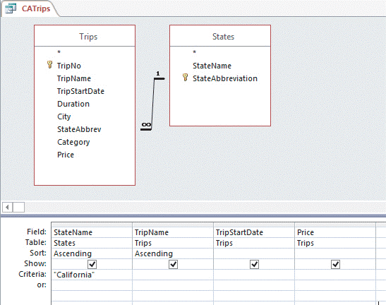
Use Query Design View (Slide 2 of 2)
Query in Design View

Slide 9
Sort and Find Data (Slide 1 of 4)
The Access sort and find features are tools that help you quickly organize and find data in a table or query datasheet.
Data can be sorted by clicking the list arrow on a datasheet’s column heading, then click a sorting option

Slide 10
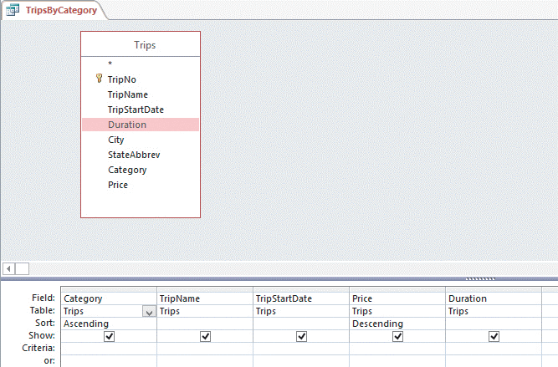
Sort and Find Data (Slide 2 of 4)
Changing sort orders for a query

Slide 11
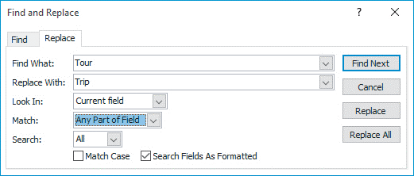
Sort and Find Data (Slide 3 of 4)
Find and Replace dialog box

Slide 12
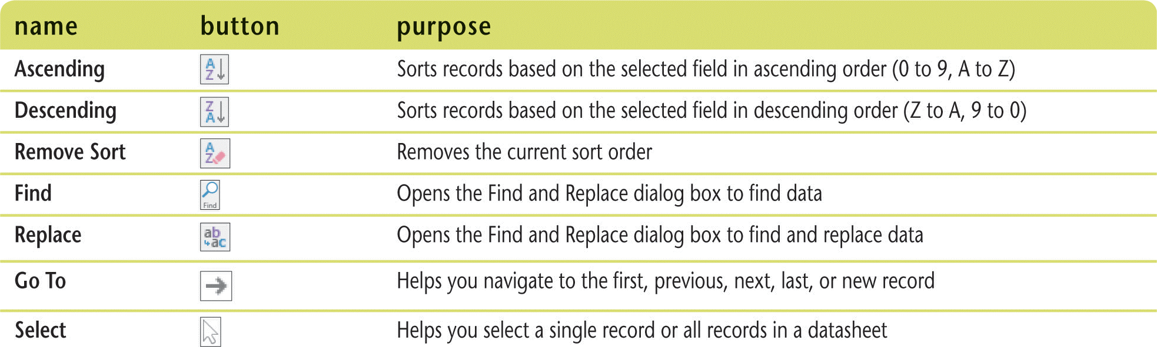
Sort and Find Data (Slide 4 of 4)
Sort and Find buttons

Slide 13
Filter Data (Slide 1 of 4)
Filtering provides a temporary way to display a subset of records that match given criteria
Filters are not used to calculate sums, averages, counts, etc.
Filters are removed when the datasheet is closed
Filters can be saved as queries
Filter By Selection: Filtering by a given field value. Filters records for an exact match.
Filter By Form: Filters by comparative data

Slide 14
Filter Data (Slide 2 of 4)
Wildcards
Used to search for a pattern; represents any character
Entered as criteria
? Used to search for a single character
* Used to search for any number of characters
Often used with LIKE operator

Slide 15
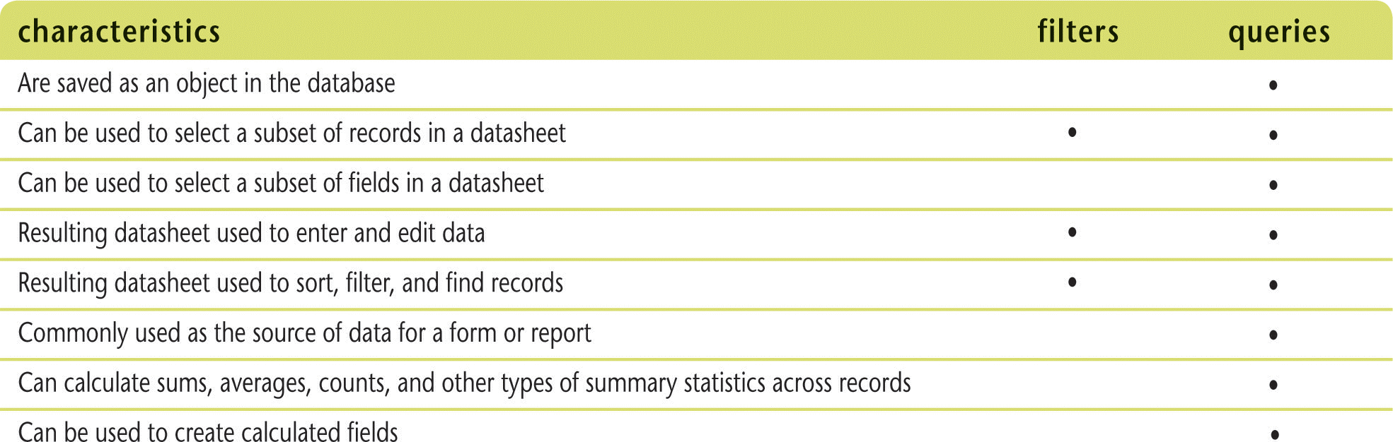
Filter Data (Slide 3 of 4)
Filters vs. queries

Slide 16
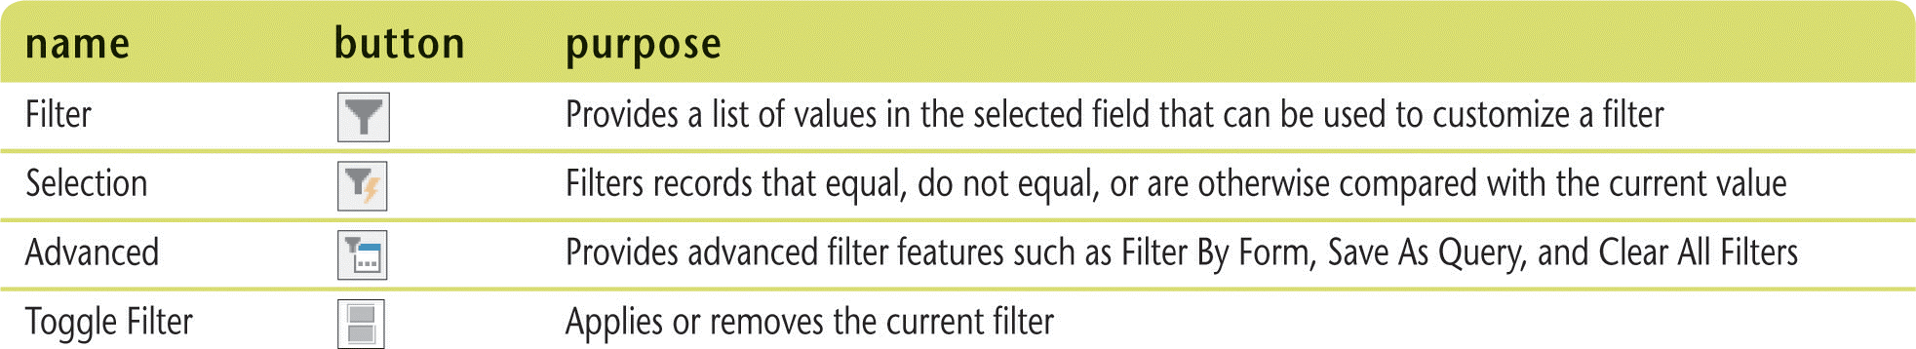
Filter Data (Slide 4 of 4)
Filter buttons

Slide 17
Apply AND Criteria (Slide 1 of 4)
Criteria are tests or limiting conditions which restrict retrieval
AND criteria means all criteria must be true for the record to be selected
Created by entering two or more criteria in the same Criteria row of the query design grid
Criteria Syntax
Quotation marks (“) around text criteria and pound signs (#) around date criteria are automatically added by Access
Criteria in Number, Currency, and Yes/No fields are not surrounded by any characters

Slide 18
Apply AND Criteria (Slide 2 of 4)
Searching for blank fields
Is Null – Finds all records where no entry has been made
Is Not Null – Finds all records where any entry has been made (even if zero)

Slide 19
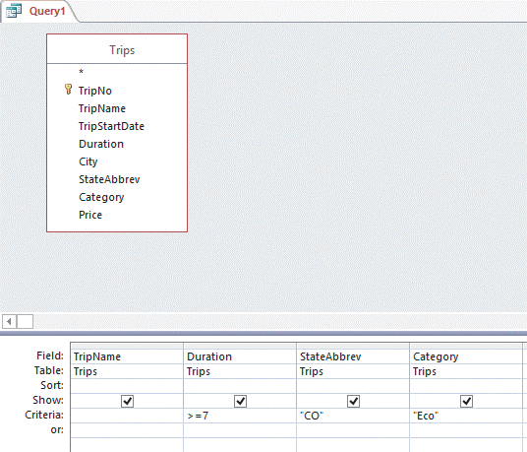
Apply AND Criteria (Slide 3 of 4)
Query Design View with AND criteria

Slide 20
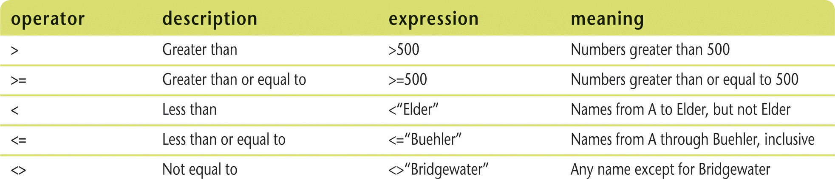
Apply AND Criteria (Slide 4 of 4)
Comparison operators

Slide 21
Apply OR Criteria (Slide 1 of 2)
OR criteria means any one criterion must be true for the record to be selected
Created by entering two or more criteria on different Criteria rows of the query design grid
Also created by entering two or more criteria in the same Criteria cell separated by OR

Slide 22
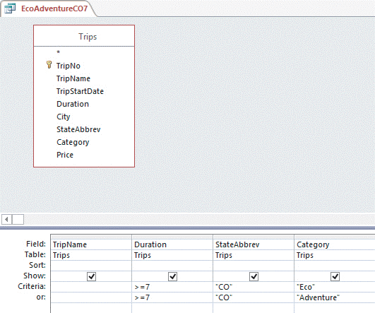
Apply OR Criteria (Slide 2 of 2)
Query Design View with OR criteria

Slide 23
Format a Datasheet (Slide 1 of 2)
Change font size
Change font face
Change colors
Change gridlines

Slide 24
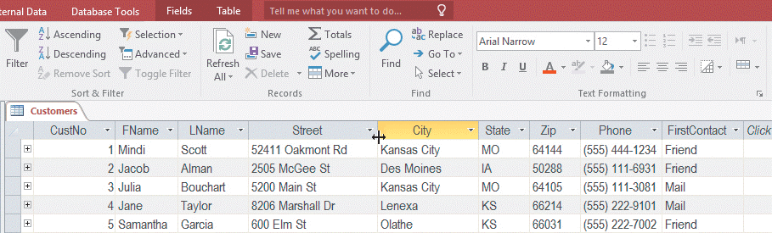
Format a Datasheet (Slide 2 of 2)
Text Formatting group
Formatting a datasheet

